Slide 1
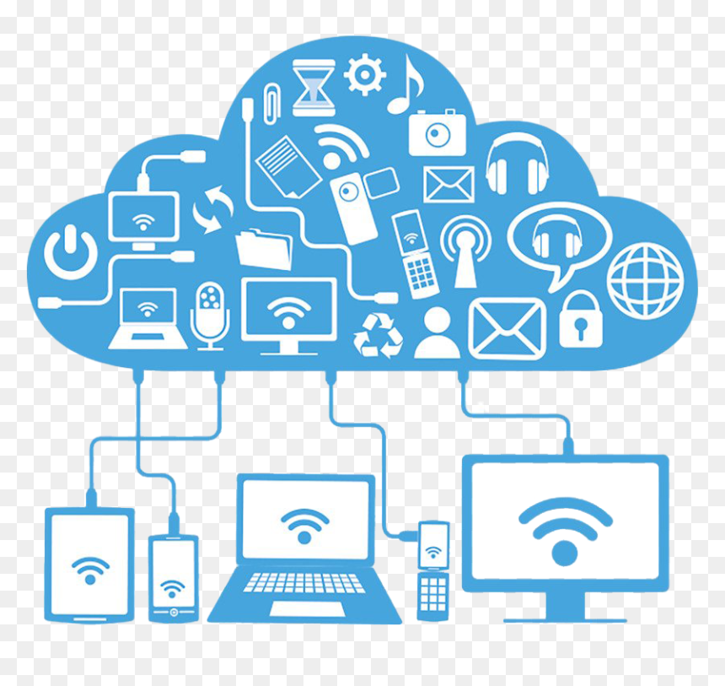
Week 5 and 6 Understanding Cloud Computing
Cloud Computing
Dr. Rafiullah Khan
ICS/IT
https://rafiyz.github.io/courses/CloudComp/cloud.htm

Slide 2

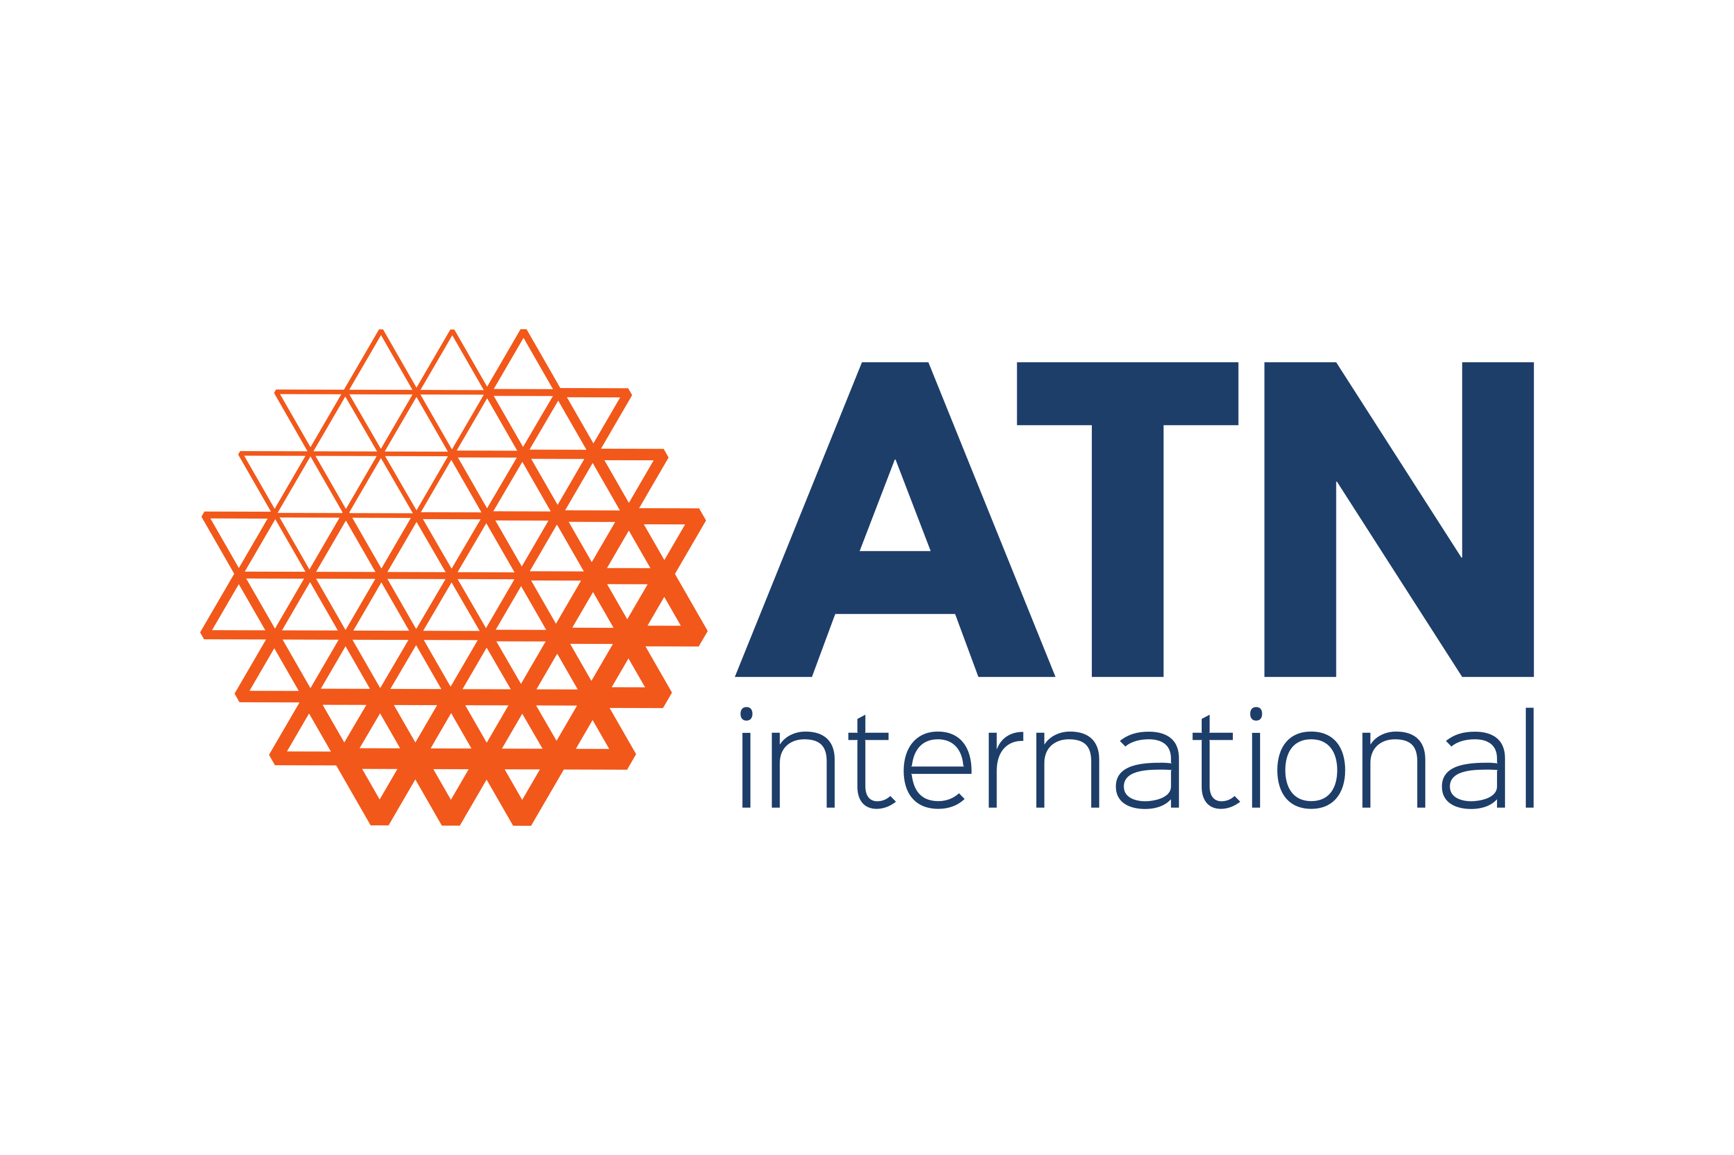
Cloud Migration Strategy for ATN (Case Study)
Overview:
Atlantic Tele-Network, Inc.,(ATN), a leading telecommunications equipment provider, faces challenges due to a complex IT landscape resulting from acquisitions.
Seeking to improve competitiveness and reduce costs, ATN explores cloud computing adoption as a solution.
Challenges:
Heterogeneous IT environment with overlapping applications leads to high maintenance costs.
Initial outsourcing initiative does not resolve operational inefficiency.
Overwhelmed by the abundance of cloud providers and products.

Slide 3

Strategy
ATN plans a cloud computing adoption roadmap focusing on IT optimization and cost reduction.
Evaluation of applications to identify candidates for migration based on factors like complexity and business criticality.
Development of target application architecture and preliminary business case to document cost savings and benefits.
Implementation of a pilot project to migrate selected applications to a PaaS platform.

Slide 4

Results:
Successful migration of smaller applications to the cloud platform.
Positive feedback and results from the pilot project lead to a strategic initiative to migrate additional areas of the company to the cloud.
Conclusion:
By partnering with CloudEnhance (consultant) and following a structured migration process, ATN achieves initial success in adopting cloud computing.
Continued migration efforts are planned to realize further cost savings and optimization across the organization.

Slide 5
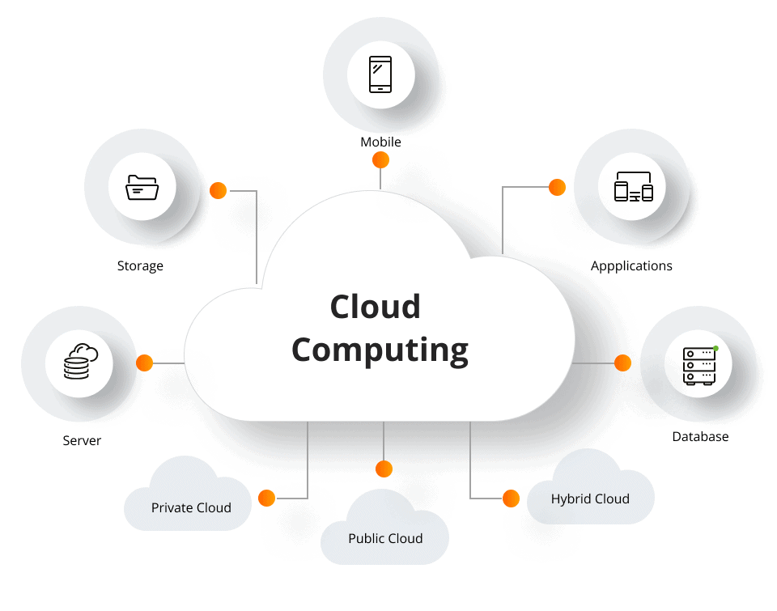
A Brief History
Utility Computing: The idea of computing in a “cloud” traces back to the origins of utility computing, a concept that computer scientist John McCarthy publicly proposed in 1961:
“If computers of the kind I have advocated become the computers of the future, then computing may someday be organized as a public utility just as the telephone system is a public utility. The computer utility could become the basis of a new and important industry.”
In 1969, Leonard Kleinrock, a chief scientist of the Advanced Research Projects Agency Network or ARPANET project that seeded the Internet, stated:
“As of now, computer networks are still in their infancy, but as they grow up and become sophisticated, we will probably see the spread of ‘computer utilities’”

Slide 6
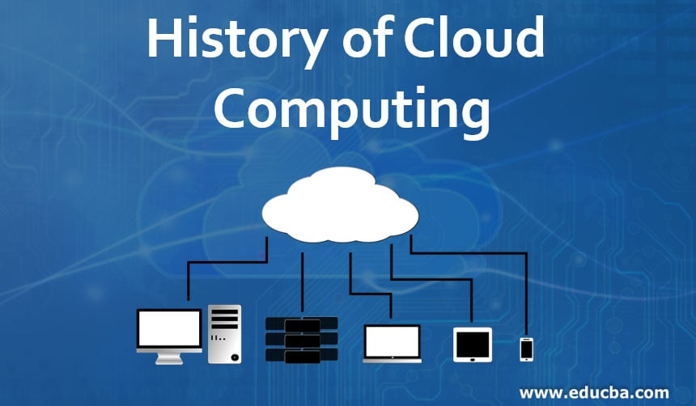
History
Internet-Based Utilities Since the 1990s (Examples of Early Services)
Search Engines: Yahoo!, Google
Email Services: Hotmail, Gmail
Open Publishing Platforms: MySpace, Facebook, YouTube
Social Media: Twitter, LinkedIn
Significance
Popularized and validated core concepts of modern cloud computing.
The Rise of Enterprise Cloud Services
Late 1990s: (Salesforce.com) Pioneered remotely provisioned services for enterprises.
2002: Amazon Web Services (AWS):
Introduced enterprise-oriented services.
Provided remotely provisioned storage, computing resources, and business functionality.
2006:The term “Cloud Computing” entered the commercial space.
Amazon Elastic Compute Cloud (EC2): Enabled organizations to “lease” computing capacity
and processing power.
Google Apps: Introduced browser-based enterprise applications.

Slide 7
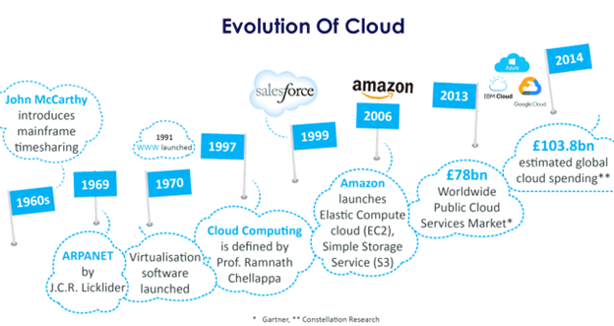

Slide 8
Business Drivers & Technological Innovations
Business Drivers
Capacity Planning
Cost Reduction
Organizational Agility
Technology Innovations
Clusters
Grid
Virtualization
Web Services

Slide 9
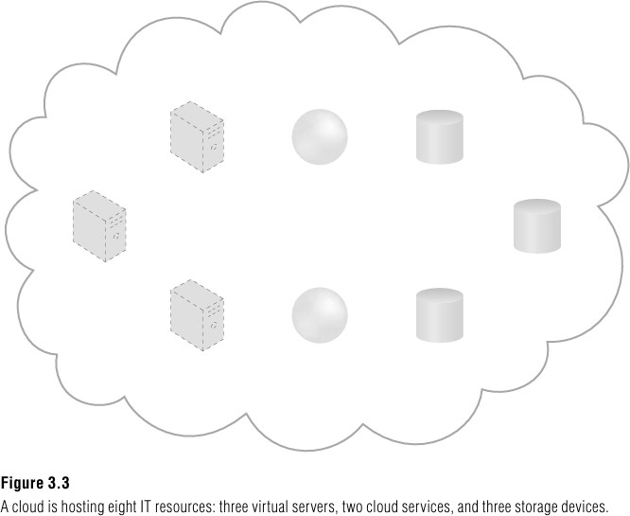
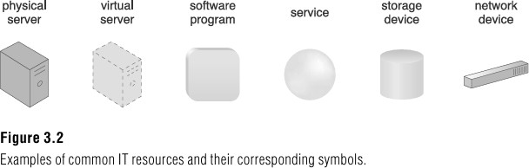
Basic Concepts and Terminology
Cloud: A cloud refers to a distinct IT environment that is designed for the purpose of remotely provisioning scalable and measured IT resources.
IT Resource: An IT resource is a physical or virtual IT-related artifact that can be either software-based, such as a virtual server or a custom software program, or hardware-based, such as a physical server or a network device.

Slide 10
Concepts (Continue)
On-Premise: An IT resource that is hosted in a conventional IT enterprise within an organizational boundary (that does not specifically represent a cloud) is considered to be located on the premises of the IT enterprise, or on-premise.
Cloud Consumers and Cloud Providers: The party that provides cloud-based IT resources is the cloud provider. The party that uses cloud-based IT resources is the cloud consumer.

Slide 11
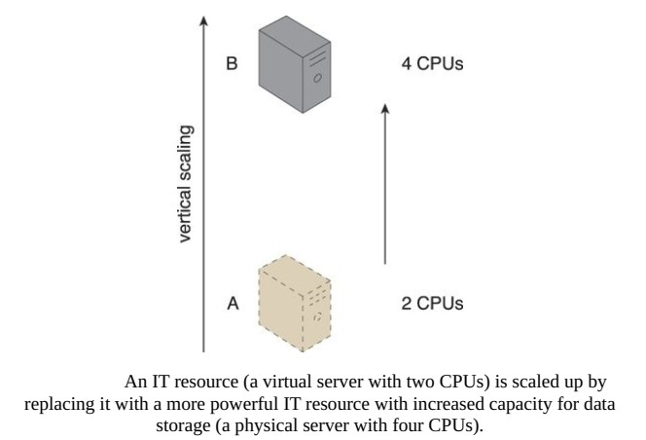
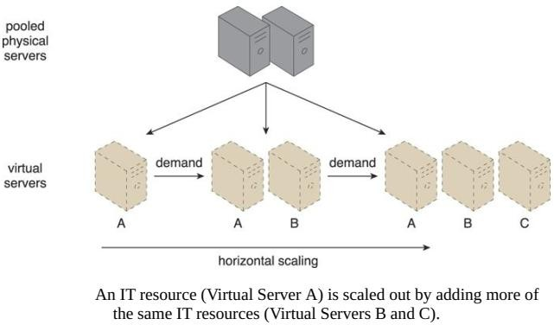
Cont.…
Scaling: the ability of the IT resource to handle increased or decreased usage demands. The following are types of scaling:
Horizontal Scaling – The allocating (scaling out) or releasing (scaling in) of IT resources that are of the same type is referred to as horizontal scaling
Vertical Scaling – The replacement of an IT resources by another with higher (scale up) or lower (scale down) capacity, is referred to as vertical scaling

Slide 12
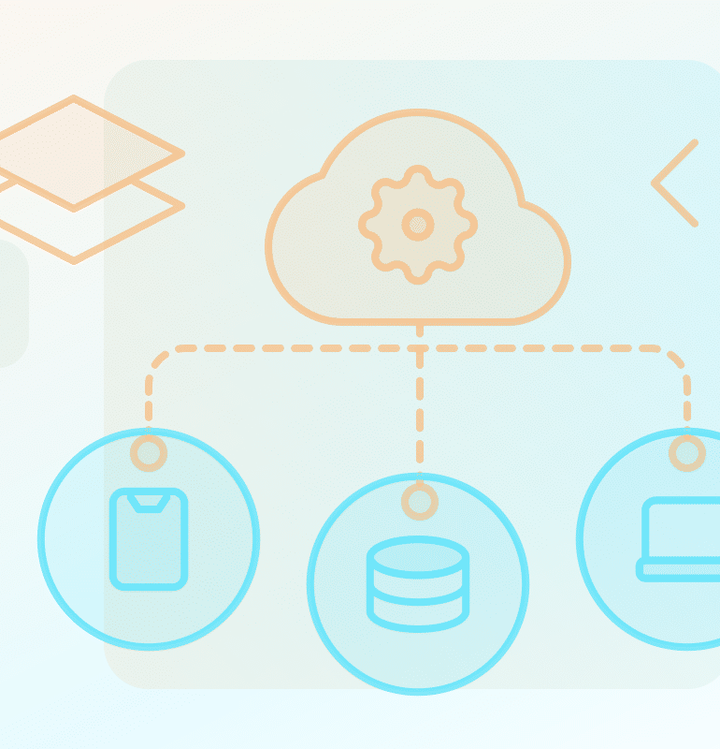
Concepts
Cloud Service: A cloud service is any IT resource that is made remotely accessible via a cloud.
Cloud Service Consumer: The cloud service consumer is a temporary runtime role assumed by a software program when it accesses a cloud service.
Cloud Service Owner: The person or organization that legally owns a cloud service is called a cloud service owner.
Cloud Resource Administrator: The person or organization responsible for administering a cloud-based IT resource (including cloud services).
Cloud Broker: This role is assumed by a party that assumes the responsibility of managing and negotiating the usage of cloud services between cloud consumers and cloud providers.
Organizational Boundary: An organizational boundary represents the physical perimeter that surrounds a set of IT resources that are owned and governed by an organization e.g. Trust Boundary.

Slide 13
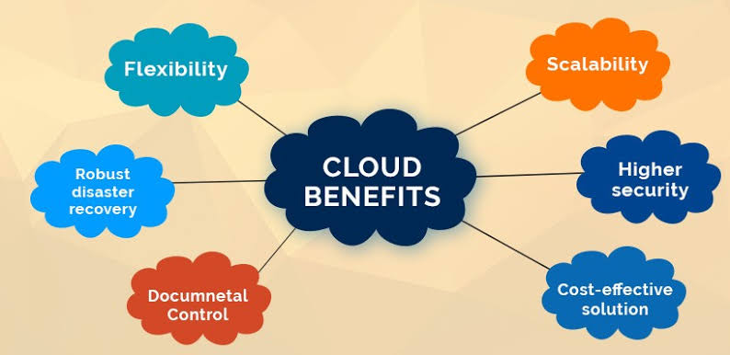
Goals and Benefits
Reduced Investments and Proportional Costs
Cloud services enable businesses to minimize upfront investments in hardware and infrastructure
Increased Scalability
Cloud computing allows for seamless scaling of resources up or down based on demand
Increased Availability and Reliability
Cloud providers offer robust infrastructure and redundancy measures, ensuring high availability and reliability of services

Slide 14
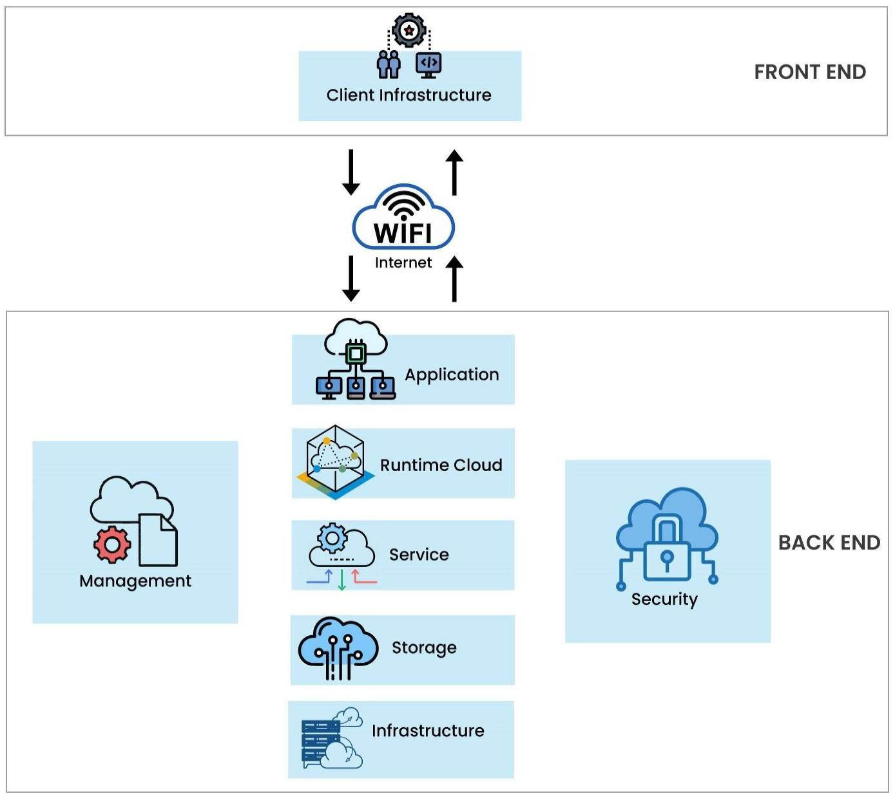
Cloud Computing Architecture
The Cloud Computing architecture comprises of many cloud components, each of them are loosely coupled. We can broadly divide the cloud architecture into two parts:
Front End
Back End
Each of the ends are connected through a network, usually via Internet.
The diagram shows the graphical view of cloud computing architecture

Slide 15
Cloud Computing Architecture (Cont.…)
Front End refers to the client part of cloud computing system. It consists of
interfaces and applications that are required to access the cloud computing platforms, e.g., Web Browser.
Back End refers to the cloud itself. It consists of all the resources required
to provide cloud computing services. It comprises of huge data storage,
virtual machines, security mechanism, services, deployment models, servers, etc.
Points to consider
It is the responsibility of the back end to provide built-in security mechanism, traffic control and protocols.
The server employs certain protocols, known as middleware, helps the connected devices to communicate with each other.

Slide 16
The NIST Definition of Cloud Computing
Cloud computing is a model for enabling ubiquitous, convenient, on-demand network access to a shared pool of configurable computing resources (e.g., networks, servers, storage, applications, and services) that can be rapidly provisioned and released with minimal management effort or service provider interaction.
This cloud model is composed of five essential characteristics, three service models, and four deployment models.

Slide 17
Cloud Characteristics
On-demand self-service
A consumer can unilaterally provision computing capabilities, such as server time and network storage, as needed automatically without requiring human interaction with each service provider.
Broad network access (Ubiquitous access)
It represents the ability for a cloud service to be widely accessible.
Establishing ubiquitous access for a cloud service can require support for a range of devices, transport protocols, interfaces, and security technologies.
Resource pooling (using Multitenancy)
The provider’s computing resources are pooled to serve multiple consumers using a multi- tenant model, with different physical and virtual resources dynamically assigned and reassigned according to consumer demand.
There is a sense of location independence in that the customer generally has no control or knowledge over the exact location of the provided resources but may be able to specify location at a higher level of abstraction (e.g., country, state, or datacenter).

Slide 18
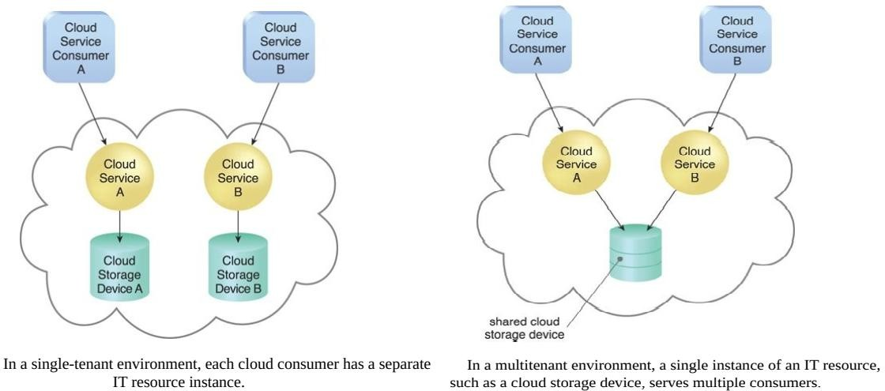
Cont.…
Rapid Elasticity
Elasticity is the automated ability of a cloud to transparently scale IT resources, as required in response to runtime conditions or as pre-determined by the cloud consumer or cloud provider.
Measured Service
The measured usage characteristic represents the ability of a cloud platform to keep track of the usage of its IT resources, primarily by cloud consumers.
Based on what is measured, the cloud provider can charge a cloud consumer only for the IT resources actually used and/or for the timeframe during which access to the IT resources was granted.

Slide 19
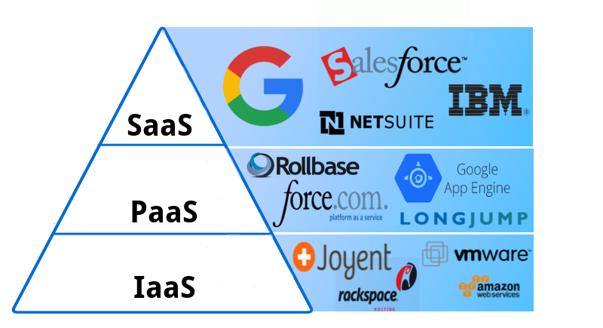
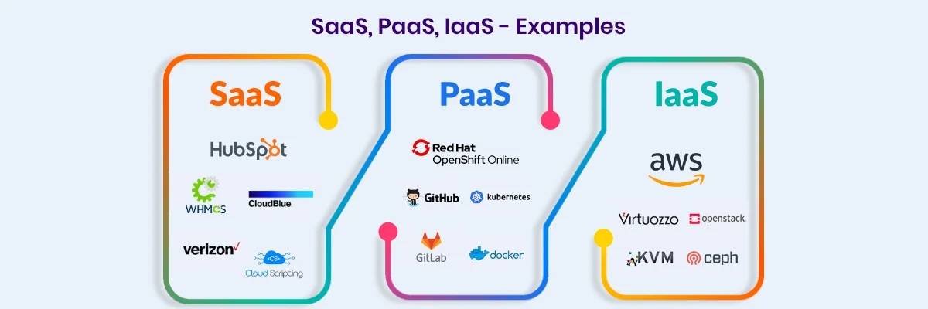
Cloud Service Models
A cloud service/delivery model represents a specific, pre-packaged combination of IT resources offered by a cloud provider.
Three common cloud delivery models have become widely established and formalized:
Infrastructure-as-a-Service (IaaS)
Platform-as-a-Service (PaaS)
Software-as-a-Service (SaaS)
Many specialized variations of the three base cloud delivery models have emerged, each comprised of a distinct combination of IT resources. Some examples include:
Storage-as-a-Service, Database-as-a-Service, Security-as-a-Service, Communication-
as-a-Service, Integration-as-a-Service, Testing-as-a-Service, Process-as-a-Service

Slide 20
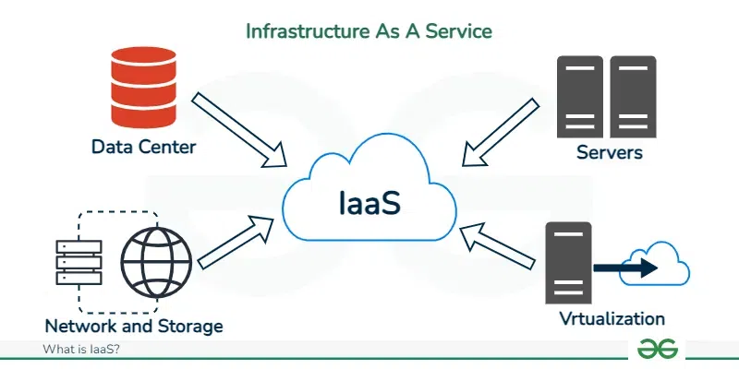
Infrastructure as a Service (IaaS)
The IaaS delivery model represents a self-contained IT environment
comprised of infrastructure-centric IT resources that can be accessed and managed via cloud service-based interfaces and tools.
IaaS provides access to fundamental resources such as physical machines,
virtual machines, virtual storage, etc., Apart from these resources, the IaaS also offers:
Virtual machine disk storage
Virtual local area network (VLANs)
Load balancers
IP addresses
Software bundles
All of the above resources are made available to end user via server
virtualization. Moreover, these resources are accessed by the customers as if they own them.

Slide 21
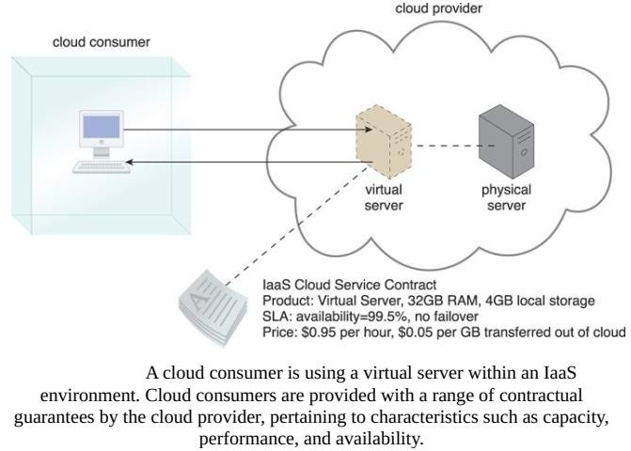
Model

Slide 22
Characteristics
Here are the characteristics of IaaS service model:
Virtual machines with pre-installed software.
Virtual machines with pre-installed Operating Systems such as Windows, Linux, and Solaris.
On-demand availability of resources.
Allows to store copies of particular data in different locations.
The computing resources can be easily scaled up and down.

Slide 23
Benefits
IaaS allows the cloud provider to freely locate the infrastructure over the Internet in a cost-effective manner. Some of the key benefits of IaaS are listed below:
Full Control of the computing resources through Administrative Access to VMs.
Flexible and Efficient renting of Computer Hardware.
Portability, Interoperability with Legacy Applications.

Slide 24

Full Control of the computing resources through Administrative Access to VMs
IaaS allows the consumer to access computing resources through administrative access to virtual machines in the following manner:
Consumer issues administrative command to cloud provider to run the virtual machine or to save data on cloud's server.
Consumer issues administrative command to virtual machines they owned to start web server or installing new applications.

Slide 25
Flexibility and Efficient Renting of Computing Resources
IaaS resources such as virtual machines, storages, bandwidth, IP addresses, monitoring services, firewalls, etc., all are made available to the consumers on rent.
The consumer has to pay based the length of time a consumer retains a resource.
Also with administrative access to virtual machines, the consumer can also run any software, even a custom operating system.

Slide 26
Portability and Interoperability with Legacy Application
It is possible to maintain legacy between applications and workloads between IaaS clouds.
For example, network applications such as web server, e-mail server that normally runs on consumer-owned server hardware can also be run from VMs in IaaS cloud

Slide 27

Issues of IaaS
IaaS shares issues with PaaS and SaaS, such as Network dependence and browser based risks. It also have some specific issues associated with it such as:
Compatibility with legacy security vulnerabilities
Because IaaS offers the consumer to run legacy software in provider's infrastructure, therefore it exposes consumers to all of the security vulnerabilities of such legacy software.
Virtual Machine Sprawl
The VM can become out of date with respect to security updates because IaaS allows the
consumer to operate the virtual machines in running, suspended and off state. However, the provider can automatically update such VMs, but this mechanism is hard and complex.
Robustness of VM Level Isolation
IaaS offers an isolated environment to individual consumers through hypervisor. Hypervisor is
a software layer that includes hardware support for virtualization to split a physical computer into multiple virtual machines.
Data Erase Practices
The consumer uses virtual machines that in turn uses the common disk resources provided
by the cloud provider. When the consumer releases the resource, the cloud provider must
ensure that next consumer to rent the resource does not observe data residue from previous consumer.

Slide 28
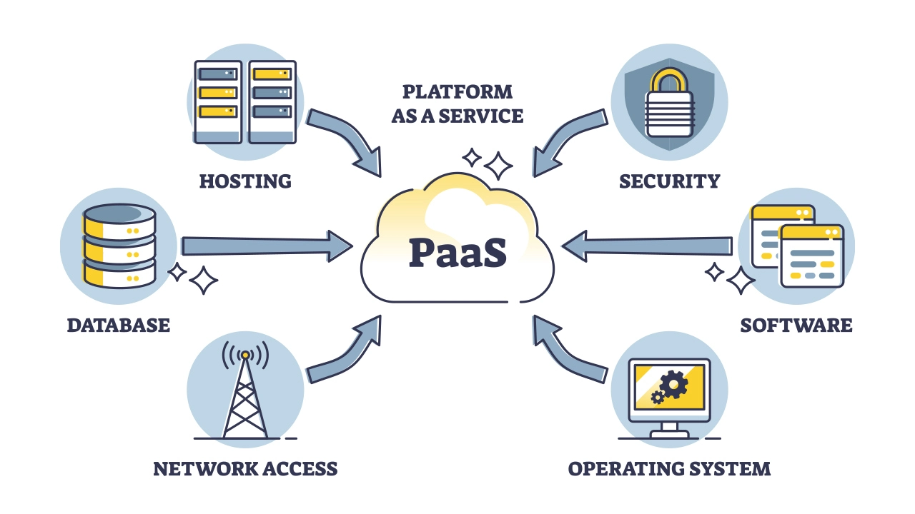
Platform as a Service (PaaS)
The PaaS delivery model represents a pre-defined “ready-to-use”
environment typically comprised of already deployed and configured IT resources.
Specifically, PaaS relies on (and is primarily defined by) the usage of a
readymade environment that establishes a set of pre-packaged products
and tools used to support the entire delivery lifecycle of custom applications.
PaaS offers
the runtime environment for applications.
development & deployment tools, required to develop applications.
a feature of point-and-click tools that enables non-developers to create web applications.
Google's App Engine, Force.com are examples of PaaS offering vendors.
Developer may log on to these websites and use the built-in API to create web-based applications.

Slide 29
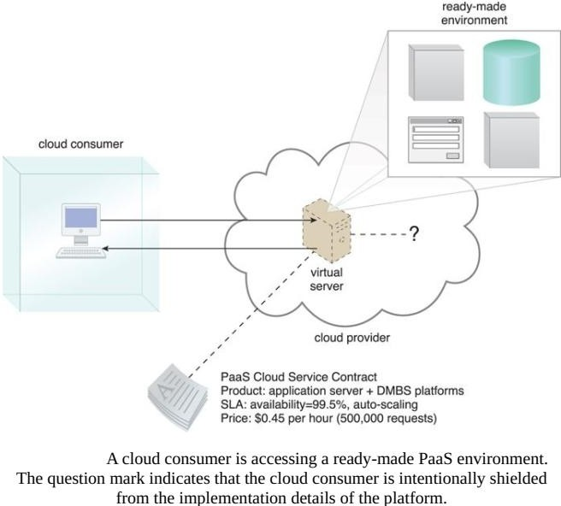
PaaS Model

Slide 30
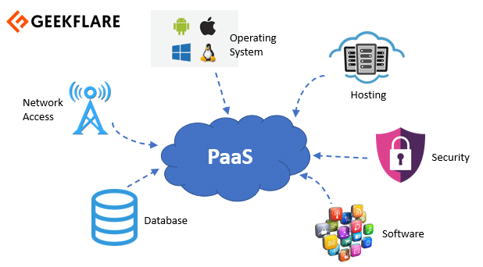
Characteristics
PaaS offers browser based development environment. It allows the developer to create database and edit the application code either via Application Programming Interface or point-and-click tools.
PaaS provides built-in security, scalability, and web service interfaces.
PaaS provides built-in tools for defining workflow and approval processes
and defining business rules.
It is easy to integrate with other applications on the same platform.
PaaS also provides web services interfaces that allow us to connect the applications outside the platform.

Slide 31
Advantages and Disadvantages of PaaS
Advantages
Lower Administrative Overhead
Consumer need not to bother much about the administration because it's the responsibility of cloud provider.
Lower Total Cost of Ownership
Consumer need not purchase expensive hardware, servers, power and data storage.
Scalable Solutions
It is very easy to scale up or down automatically based on application resource demands.
More Current System Software
It is the responsibility of the cloud provider to maintain software versions and patch installations.
Disadvantages
The disadvantage of using PaaS is that the developer lock-in with a particular vendor.
For example, an application written in Python against Google's API using Google's App Engine
is likely to work only in that environment. Therefore, the vendor lock-in is the biggest problem in PaaS.

Slide 32
Issues in PaaS
PaaS also place significant burdens on consumer's browsers to maintain reliable and secure connections to the provider systems. Therefore, PaaS shares many of the issues of SaaS. However, there are some specific issues associated with PaaS such as:
Lack of Portability between PaaS Clouds
Although standard languages are used yet the implementations of platforms services may vary. For example, file, queue, or hash table interfaces of one platform may differ from another, making it difficult to transfer workloads from one platform to another.
Event Based Processing Scheduling
The PaaS applications are event oriented which poses resource constraints on applications, i.e., they have to answer a request in a given interval of time.

Slide 33
PaaS Types
Based on the functions, the PaaS can be classified into different types
Application Development Platforms
Provides tools and frameworks for developing, testing, and deploying applications.
Examples: Heroku, Google App Engine, Microsoft Azure App Service.
Database PaaS
Offers managed database services for storing, managing, and scaling databases.
Examples: Amazon RDS, Google Cloud SQL, Microsoft Azure SQL Database.
Integration PaaS (iPaaS)
Facilitates integration of applications and systems within organizations or across cloud environments.
Examples: MuleSoft Anypoint Platform, Dell Boomi, Informatica Cloud.
OpenPaaS
Utilizes open-source software to provide a platform for running applications.
Examples: Cloud Foundry, OpenShift by Red Hat, Apache Stratos.

Slide 34
Software as a Service
Software as a Service(SaaS ): A software program positioned as a shared
cloud service and made available as a “product” or generic utility to the
end users.
It refers to a software that is deployed on a hosted service and is accessible
via Internet. There are several SaaS applications, some of them are listed below:
Billing and Invoicing System
Customer Relationship Management (CRM) applications
Help Desk Applications
Human Resource (HR) Solutions
Some of the SaaS applications are not customizable such as an Office Suite.
But SaaS provides us Application Programming Interface (API), which allows the developer to develop a customized application.

Slide 35
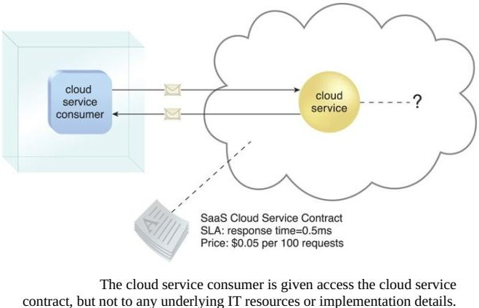
Model

Slide 36
Characteristics
Here are the characteristics of SaaS service model:
SaaS makes the software available over the Internet.
The Software are maintained by the vendor rather than where they are running.
The license to the software may be subscription based or usage based. And it is
billed on recurring basis.
SaaS applications are cost effective since they do not require any maintenance at end user side.
They are available on demand.
They can be scaled up or down on demand.
They are automatically upgraded and updated.
SaaS offers share data model. Therefore, multiple users can share single instance of infrastructure. It is not required to hard code the functionality for individual users.
All users are running same version of the software.

Slide 37
Benefits
Modest Software Tools
The SaaS application deployment requires a little or no client side software installation which results in the following benefits:
No requirement for complex software packages at client side
Little or no risk of configuration at client side
Efficient Use of Software Licence
The client can have single license for multiple computers running at different locations which reduces the licensing cost. Also, there is no requirement for license servers because the software runs in the provider's infrastructure.
Centralized Management of Data
The data stored by the cloud provider is centralized. However, the cloud providers may store data in a decentralized manner for sake of redundancy and reliability.
Platform Responsibilities Managed by provider
All platform responsibilities such as backups, system maintenance, security, hardware refresh, power management, etc., are performed by the cloud provider.

Slide 38
Issues
Browser Based Risks
If the consumer visits malicious website and browser becomes infected, and the
subsequent access to SaaS application might compromise the consumer's data.
To avoid such risks, the consumer can use multiple browsers and dedicate a specific browser to access SaaS applications or can use virtual desktop while accessing the SaaS applications.
Network Dependence
The SaaS application can be delivered only when network is continuously available.
Also network should be reliable but the network reliability cannot be guaranteed either by cloud provider or the consumer.
Lack of portability between SaaS Clouds
Transferring workloads from one SaaS cloud to another is not so easy because work flow, business logics, user interfaces, support scripts can be provider specific.

Slide 39
Open SaaS
Open SaaS uses SaaS applications that are developed using open source programming language.
These SaaS applications can run on any open source operating system and database.
Open SaaS has several benefits, some of these are listed below:
No License Required
Low Deployment Cost
Less Vendor Lock-in
More portable applications
More Robust Solution

Slide 40
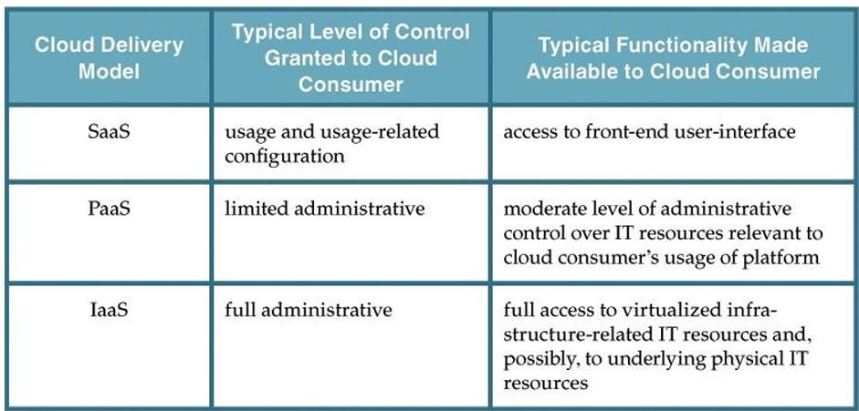
Comparing Cloud Delivery Models
Control Level in Cloud Delivery Models

Slide 41
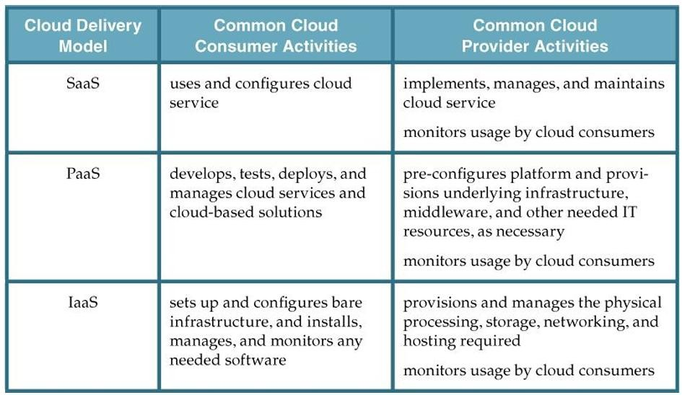
Cont.
Responsibilities and Usage

Slide 42
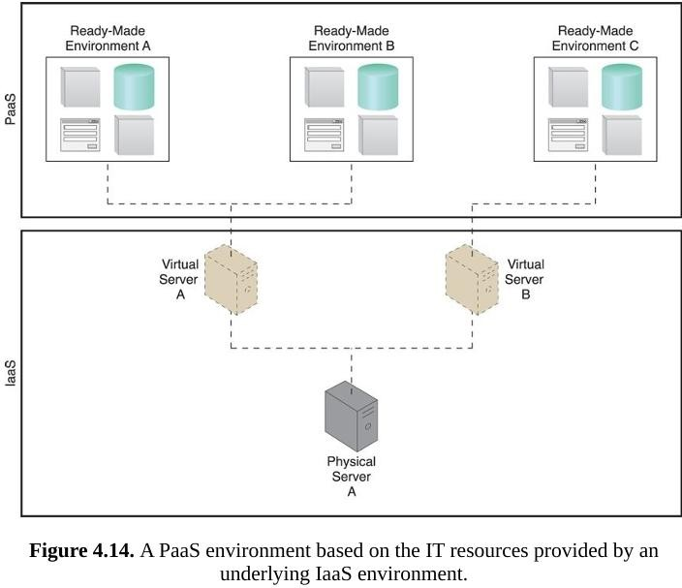
Combining Cloud Delivery Models
IaaS + PaaS
IaaS + PaaS + SaaS

Slide 43
Cloud Deployment Models
A cloud deployment model represents a specific type of cloud environment, primarily distinguished by ownership, size, and access.
There are four common cloud deployment models:
Public cloud
Community cloud
Private cloud
Hybrid cloud

Slide 44
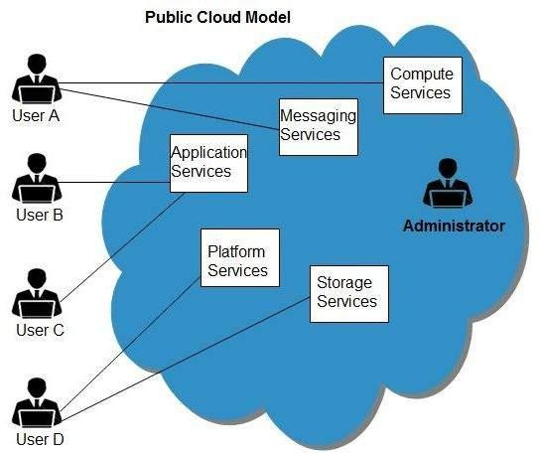
Public Cloud
The cloud infrastructure is provisioned for open use by the general public.
It may be owned, managed, and operated by a business, academic, or government organization, or some combination of them.
It exists on the premises of the cloud provider.
The Public Cloud allows systems and services to be easily accessible, e.g., Google, Amazon, Microsoft offers cloud services via Internet.

Slide 45
Benefits
Cost Effective: Since public cloud share same resources with large number of consumer, it has low cost.
Reliability: Since public cloud employs large number of resources from
different locations, if any of the resource fail, public cloud can employ another one.
Flexibility: It is also very easy to integrate public cloud with private cloud, hence gives consumers a flexible approach.
Location Independence: Since, public cloud services are delivered through Internet, therefore ensures location independence.
Utility Style Costing: Public cloud is also based on pay-per-use model and resources are accessible whenever consumer needs it.
High Scalability: Cloud resources are made available on demand from a pool of resources, i.e., they can be scaled up or down according the requirement

Slide 46
Disadvantages
Low Security: In public cloud model, data is hosted off-site and resources are shared publicly, therefore does not ensure higher level of security.
Less Customizable: It is comparatively less customizable than private cloud.

Slide 47
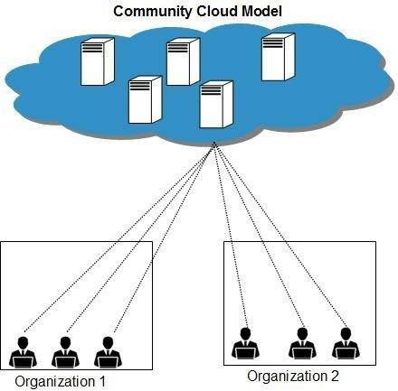
Community Cloud
The cloud infrastructure is provisioned for exclusive use by a specific community of consumers from organizations that have shared concerns (e.g., mission, security requirements, policy, and compliance considerations).
It may be owned, managed, and operated by one or more of the organizations in the community, a third party, or some combination of them, and it may exist on or off premises.
An example of a “community” of organizations accessing IT
resources from a community cloud

Slide 48
Advantages and Disadvantages
Advantages
Sharing Between Organizations: Community cloud provides an infrastructure to share cloud resources and capabilities among several organizations.
Security: Community cloud is comparatively more secure than the public
cloud.
Disadvantages
Since all data is housed at one location, one must be careful in storing data in
community cloud because it might be accessible by others.
It is also challenging to allocate responsibilities of governance, security and cost.

Slide 49
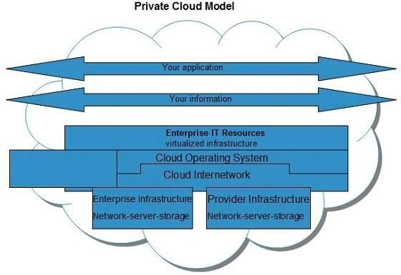
Private Cloud
The cloud infrastructure is provisioned for exclusive use by a single organization comprising multiple consumers (e.g., business units).
It may be owned, managed, and operated by the organization, a third party, or some combination of them, and it may exist on or off premises.

Slide 50
Advantages and Disadvantages
Benefits:
High Security and Privacy: Private cloud operations are not available to general public and resources are shared from distinct pool of resources, therefore, ensures high security and privacy.
More Control: Private clouds have more control on its resources and hardware than public cloud because it is accessed only within an organization.
Disadvantages:
Restricted Area: Private cloud is only accessible locally and is very difficult to deploy
globally.
Inflexible Pricing: In order to fulfil demand, purchasing new hardware is very costly.
Limited Scalability: Private cloud can be scaled only within capacity of internal hosted
resources.
Additional Skills: In order to maintain cloud deployment, organization requires more skilled and expertise
Cost: Private cloud resources are not as cost effective as public clouds

Slide 51
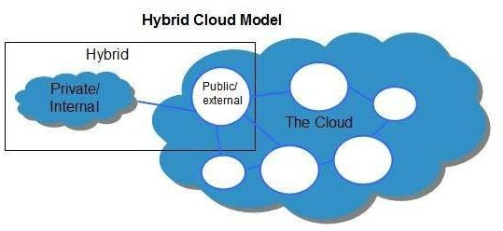
Hybrid Cloud
The cloud infrastructure is a composition of two or more distinct cloud infrastructures (private, community, or public).
The distinct infrastructures remain unique entities, but are bound together by standardized or proprietary technology that enables data and application portability (e.g., cloud bursting for load balancing between clouds).

Slide 52
Advantages and Disadvantages
Advantages
Scalability: It offers both features of public cloud scalability and private cloud scalability.
Flexibility: It offers both secure resources and scalable public resources.
Cost Efficiencies: Public cloud are more cost effective than private, therefore hybrid
cloud can have this saving.
Security: Private cloud in hybrid cloud ensures higher degree of security.
Disadvantages
Networking Issues: Networking becomes complex due to presence of private and
public cloud.
Security Compliance: It is necessary to ensure that cloud services are compliant with organization's security policies.
Infrastructural dependencies: The hybrid cloud model is dependent on internal IT
infrastructure, therefore it is necessary to ensure redundancy across data centres.

